Slide 1

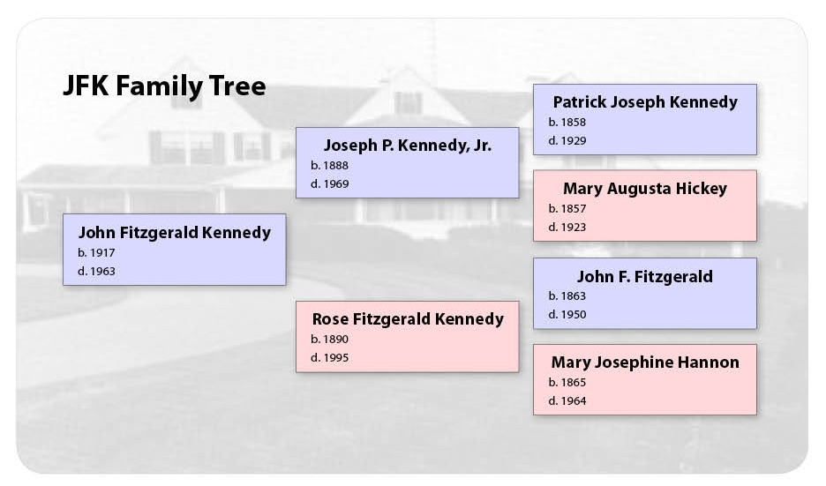
Why Data Structures?
When you must run like a cheetah.
Be a cheetah.
Fast
Low “time complexity.”
Users are impatient.
Time is finite.
Slim and Trim
Low “space complexity.”
Computers have limited stack and heap space.
Non-Linear
Many relationships do fit nicely into linear, pre-made data structures.
Family Tree Image By Mattwrite - Own work, CC BY-SA 3.0, https://commons.wikimedia.org/w/index.php?curid=17900579
Cheetah image from Pixabay

Slide 2
Data Structures Interfaces
Fast/Slim and Trim
Non-Linear
user code
linear interface /* probably */
graph data structure
/* For example,
self-balancing binary tree*/
user code
non-linear interface
graph data structure
/* For example, family tree
or adventure game */

Slide 3

Four Parts of a Loop
Starting Condition
Stopping Condition
Where we start.
Also called the “Invariant.”
Tells us when to stop.
Body
Update
What we actually want to do.
Tells us how things change.
Image from Pixabay

Slide 4
Four Parts of a Loop (for)
Stopping Condition
Starting Condition
Also called the “Invariant.”
Tells us when to stop.
Where we start.
for(int i = 0; i < numbers.length; i++){
System.out.println(numbers[i]);
}
Update
Tells us how things change.
Body
What we actually want to do.

Slide 5
Four Parts of a Loop (while)
Stopping Condition
Starting Condition
Also called the “Invariant.”
Tells us when to stop.
int i = 0;
while(i<numbers.length){
System.out.println(numbers[i]);
i++;
}
Where we start.
Body
What we actually want to do.
Update
Tells us how things change.

Slide 6
Four Parts of a Loop (recursion)
Starting Condition
Where we start.
Recurse(0, numbers);
…
public void Recurse(int i, int[] numbers){
if(i<numbers.length){
System.out.println(numbers[i]);
i++;
Recurse(i, numbers);
} }
Stopping Condition
Also called the “Invariant.”
Tells us when to stop.
Body
What we actually want to do.
Update
Recursive functions have two update parts.

Slide 7
Recursion is Stack Heavy but Flexible
Stack
Stack Heavy!
If we go too deep, or we have a bad stopping condition, we get a stack overflow exception.
Recurse(0, numbers);
…
public void Recurse(int i, int[] numbers){
if(i<numbers.length){
System.out.println(numbers[i]);
i++;
Recurse(i, numbers);
} }
Recurse(1, numbers);
…
public void Recurse(int i, int[] numbers){
if(i<numbers.length){
System.out.println(numbers[i]);
i++;
Recurse(i, numbers);
} }
Recurse(2, numbers);
…
public void Recurse(int i, int[] numbers){
if(i<numbers.length){
System.out.println(numbers[i]);
i++;
Recurse(i, numbers);
} }
Recurse(n, numbers);
…
public void Recurse(int i, int[] numbers){
if(i<numbers.length){
System.out.println(numbers[i]);
i++;
Recurse(i, numbers);
} }
Flexibile
Recursion can easily handle non-linear data structures.

